Slide 1
CSP 554 Big Data Technologies
Module 1a
Course Information
Big Data Concepts

Slide 2
If we have data, let’s look at data. If all we have are opinions, let’s go with mine. Jim Barksdale CEO of Netscape COO of FedEx Board Member of Time Warner Net worth: US$ 700 Million

Slide 3
Data Collection
In the process of data democratization… the world’s data have never been more open that today
The world’s data sources (e.g., social media, news outlets) often permit –restricted–access to their data
Web Scraping: methodically scrape website content
Application Programmable Interfaces (APIs)
ASK for permission and GET access to resource(s)
So… turn the “tap” of a data source (coding task) and store the data somewhere for analysis

Slide 4
Insight Creation
Scanning through a few dozen data records manually is easy.
But… what about thousands or millions of data records form multiple sources?
Humans are slow, Computers are fast!
Get the data, store it and then let the computer generate insights!

Slide 5
Knowledge Discovery Automating Insight Creation
The automated nontrivial extraction of implicit, previously unknown, and potentially useful information from data
Data, in its raw form, is simply a collection of elements, from which little knowledge can be gleaned
With the development of knowledge discovery techniques the value of the data is significantly improved
The goal is to distinguish from source data, something that may not be obvious but is valuable or enlightening in its discovery
Extraction of knowledge from source data is accomplished by applying data mining methods

Slide 6
Knowledge Discovery Process
Frame the problem
(Ask the right questions)
Obtain the right data
(Data ingestion, Data collection)
Process the data
(Data cleansing)
Explore the data
(Data profiling, Data transformation)
Analyze data in depth
(Data Mining)
Visualize and communicate results
(Use the discovered knowledge)
Who is your client? What exactly is the client asking you to solve? How can you translate their ambiguous request into a concrete, well-defined problem?
Is this data already available? If so, what parts of the data are useful? If not, what more data do you need? What kind of resources would it take to collect this data in a usable form?
Raw data is rarely usable out of the box. There are errors in data collection, corrupt records, missing values and other challenges. You will need to clean the data to convert it to a form that you can analyze.
You have to understand the information at a high level. What kinds of trends or correlations do you see in the data? What are the high-level characteristics and are any of them more significant than others?
Apply all the cutting-edge machinery of data analysis t(machine learning, statistics, deep learning) to unearth high-value insights and predictions.
Explain to your stakeholders what results mean, in a way that’s comprehensible and compelling.

Slide 7
Data Mining Analyzing Data in Depth
Data mining is a multidisciplinary field
drawing work from areas including:
database technology
artificial intelligence
machine learning / deep learning / neural networks
statistics
high performance computing / parallel processing
data visualization

Slide 8
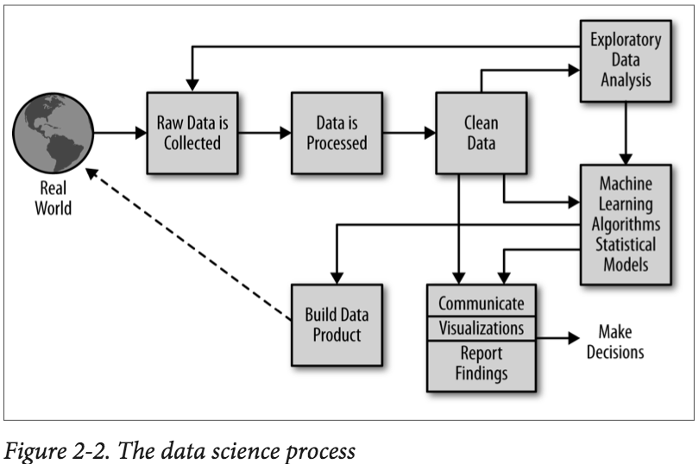
Knowledge Discovery Process Distribution of Data Science Effort
80% of KD effort is for data preparation & communication
20% of KD effort is for data mining and model creation

Slide 9
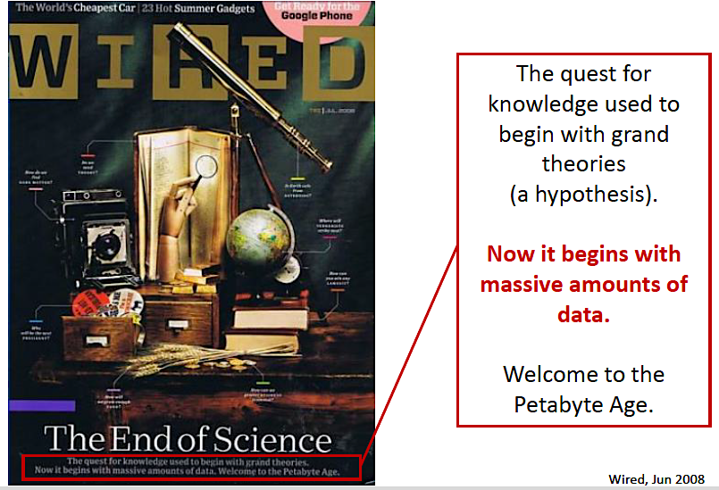

Slide 10
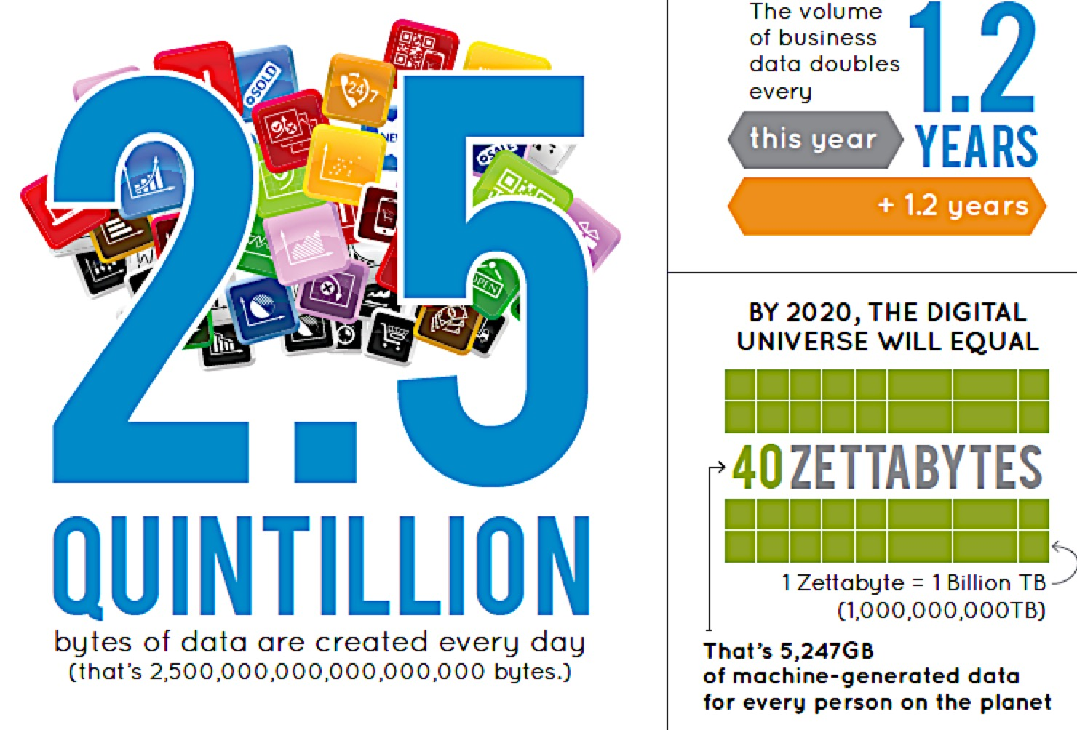
Big Data

Slide 11
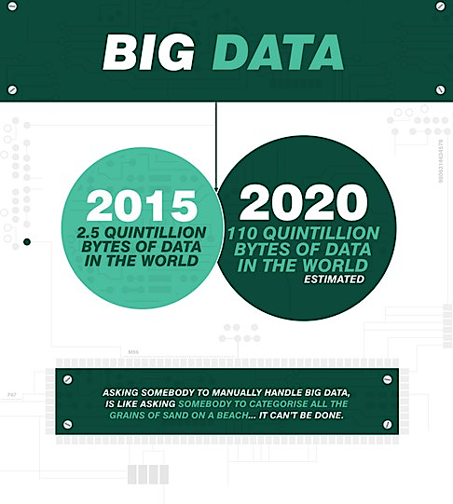

Slide 12
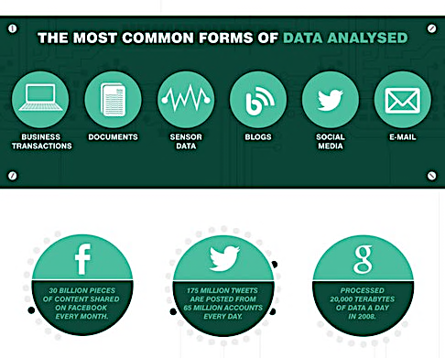

Slide 13
1 ZETTABYTE =
1,000,000,000,000,000,000,000 BYTES =
10²¹ BYTES

Slide 14
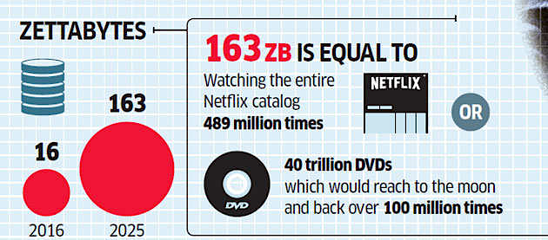
Growth of Data Volume Across Time

Slide 15
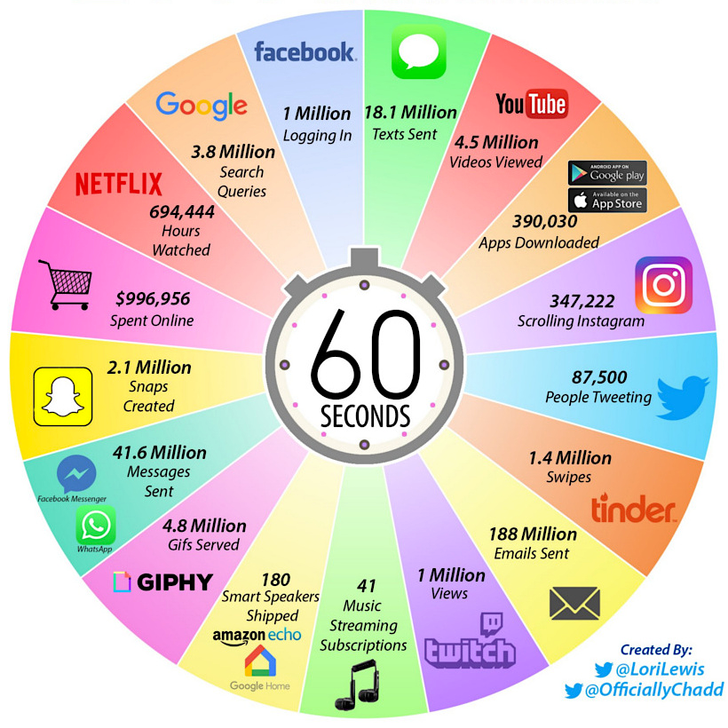
Growth of Data Streams Over Time

Slide 16
Big Data refers to datasets that are too large or complex for traditional data-processing application software to adequately deal with

Slide 17
The Challenge Posed by Big Data Why Do We Need Specialized Big Data Technology?
To remain competitive, firms absolutely must uncover insights from vast and diverse data sets.
But this data is of such size and complexity that many common software packages and systems that are used to collect, process and analyze lesser amounts or simpler format data cannot be used to generate results in a reasonable time
Big data technologies are exactly those software packages, tools and systems which are architected and implemented specifically to uncover business value from large volumes of data

Slide 18
Big Data is…a Volume Problem

Slide 19
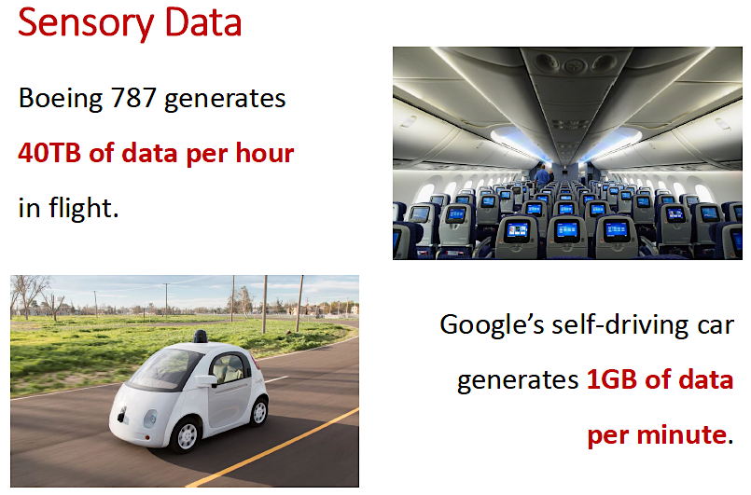

Slide 20
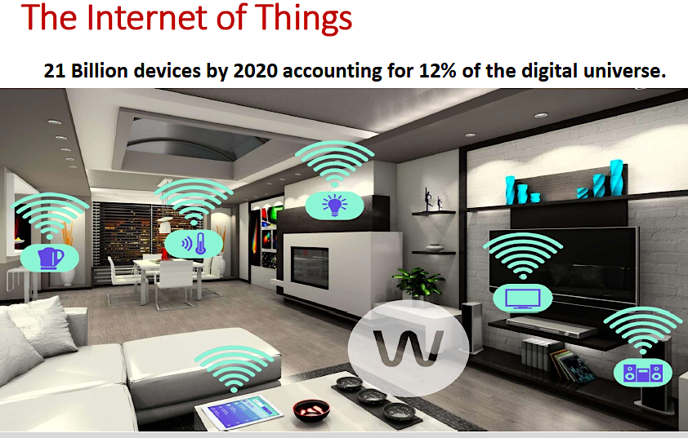

Slide 21
Big Data is…a Velocity Problem

Slide 22
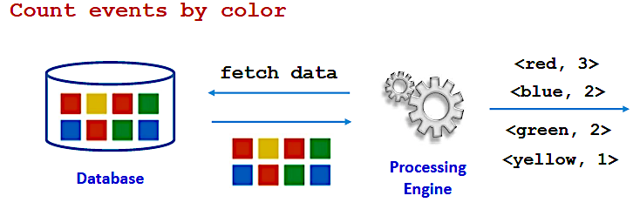
Batch Data
Assumes that the data is available when andif we want it(e.g., reading and parsing data from a file or database)
The processing engine knows the dataset in advance and controls the input rate of the data

Slide 23
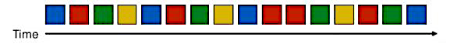
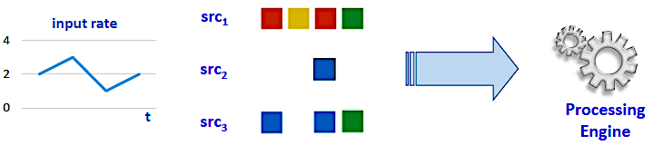
Streaming (Realtime) Data
Unbounded Data -> the volume of the data is overwhelming
Conceptually infinite sequence of data items
Push Model -> data arrives at high velocity and different rates
Potentially multiple sources pushing data to the processing engine at different rates (data distribution changes over time)

Slide 24
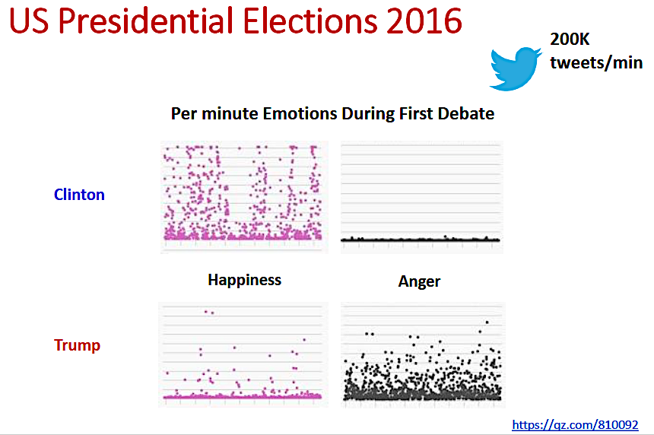

Slide 25
Big Data is…a Variety Problem

Slide 26
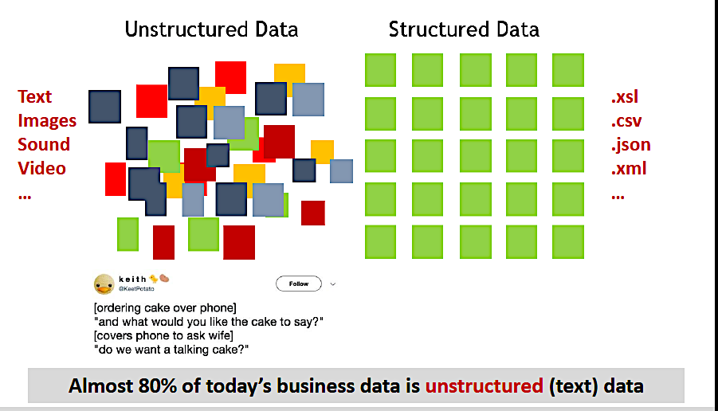

Slide 27
Big Data is…a Veracity Problem
Definition of veracity:
1: conformity with truth or fact : ACCURACY
2: devotion to the truth : TRUTHFULNESS
3: power of conveying or perceiving truth

Slide 28
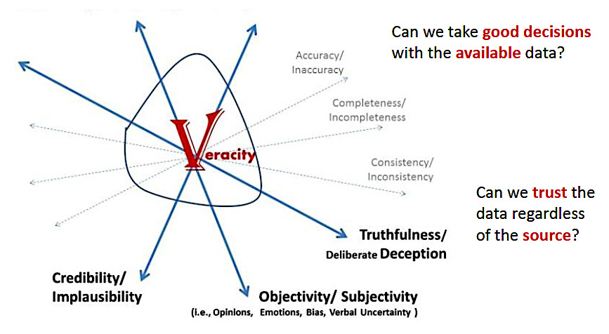
Data Quality

Slide 29
Big Data Generates Value in Several Ways
Creating transparency: making data accessible timely manner.
Enabling experimentation: collecting more accurate and detailed performance data, setting up controlling experiments.
Segmenting populations to customize actions, target promotions and advertisement.
Replacing/supporting human decisions making with automated algorithms.
Innovating new business models, products and services:
UBER, Spotify, LinkedIn, Twitter, Netflix are well-known examples of this. Big Data is affecting healthcare too

Slide 30
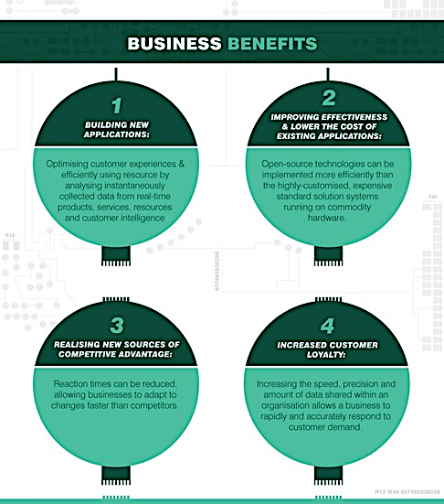

Slide 31
Course Information

Slide 32
Contact Information
Joseph Rosen
Technical Fellow
Enterprise Architect
Blue Cross and Blue Shield Association
jrosen@iit.edu (Emails responded to in a day or less)
C: 312-860-0860
Office Hours:
Virtual office hours: Thursday, 5:15pm-6:15pm Central and by appointment, all via cell

Slide 33
Course Summary
This course provides a rapid immersion into the area of big data and the technologies which have recently emerged to manage it.
We start with an introduction to the characteristics of big data and an overview of the associated technology landscape
And continue with an in depth exploration of Hadoop, the leading open source framework for big data processing.
We focus is on the most important Hadoop components such as Hive, Pig, stream processing and Spark as well as architectural patterns for applying these components.
We go on to an exploration of the range of specialized (NoSQL) database systems architected to address the challenges of managing large volumes of data
Overall the objective is to develop a sense of how to make sound decisions in the adoption and use of these technologies

Slide 34
Required Texts
Tom White. 2015. Hadoop: The Definitive Guide (4th ed.). O'Reilly Media, Inc. (TW)
Pramod J. Sadalage and Martin Fowler. 2012. NoSQL Distilled: A Brief Guide to the Emerging World of Polyglot Persistence. Addison-Wesley.(PS)

Slide 35
Free Online Texts (also Blackboard)
Jimmy Lin and Chris Dyer. 2010. Data-Intensive Text Processing with Mapreduce. Morgan and Claypool Publishers.
https://vgc.poly.edu/~juliana/courses/BigData2014/Textbooks/MapReduce-algorithms-Jan2013-draft.pdf
Anand Rajaraman and Jeffrey David Ullman. 2011. Mining of Massive Datasets. Cambridge University Press, New York, NY, USA.
http://infolab.stanford.edu/~ullman/mmds/bookL.pdf

Slide 36
Grading Policies
Short Quizzes | 15%
Assignments | 15%
Project / Paper Proposal | 5%
Project / Paper Draft | 5%
Project / Paper | 25%
Half Term Quiz | 35%
Grade Distribution
A = 100 – 90%, B = <90% – 75%, C = <75% – 60% (Undergraduate only)

Slide 37
Quiz and Exam Policy
Short Quizzes (every week or two, via Blackboard)
Each short quiz will be open notes and books and consist of multiple choice and short answer questions and should take no more than 15-20 minutes (timed) to complete.
Covers lectures, readings, assignments
The lowest short quiz score will be dropped when calculating the average short quiz score.
Since you can miss a short quiz with no penalty there are no make ups or exceptions (except as explicitly provided for by IIT policy).
Half Term Exam (via Blackboard)
The half term exam will be open notes and books and consist of multiple choice and short answer questions, some longer essay questions and take 3 hours (timed).

Slide 38
Assignments, Projects/Paper Policies
Assignments, project/paper proposals and project/paper drafts must be submitted by their announced due dates and times
You can submit any two assignments up to one week late each
Contact me well ahead of time for possible accommodations
Beyond this 5% of total points will be deducted from your assignment score for each day it is late
Without prior negotiated accommodations the final project or paper must be submitted by 11:59pm on its due date
Beyond this, 10% of total points will be deducted from your score for each day the paper or project is late

Slide 39
Project/Paper Topics
May be reviews of research papers or labs applying big data technology.
By the end of term you will have completed a paper or conducted an investigational project
Where you applied big data technology to a problem of interest to you, your community or your organization
Research papers are done individually
Projects are done in teams of 3-4
Each student registers for one of 10 project areas or to do a research paper
I assign groups of students who express interest in the same project area to a virtual team

Slide 40
Big Data Concepts IN DEPTH

Slide 41
The Rise of Big Data
Companies churn out an increasing volume of transactional data
Capturing trillions of bytes of information about their customers, suppliers, and operations
Millions of networked sensors are being embedded in the physical world
In devices such as mobile phones, smart energy meters, automobiles, and industrial machines that sense, create, and communicate data in the age of the Internet of Things (IoT).
As companies and organizations go about their business and interact with individuals, they are also generating a tremendous amount of data
Created as a by-product of other activities.
Social media sites, smartphones, and other consumer devices including PCs have allowed billions of to contribute to the amount of big data available.
And the growing volume of multimedia content has played a major role in the exponential growth in the amount of big data

Slide 42
The Rise of Big Data
In itself, the sheer volume of data is a global phenomenon—but what does it mean?
Many citizens around the world regard this collection of information with deep suspicion
Seeing the data flood as nothing more than an intrusion of their privacy.
But there is strong evidence that big data can play a significant economic role
To the benefit not only of private commerce but also of national economies and their citizens.
Data can create significant value for the world economy, enhancing the productivity and competitiveness of companies and the public sector and creating substantial economic surplus for consumers

Slide 43
The Challenge Posed by Big Data
The proliferation of data generated by enterprises has afforded an unprecedented opportunity for businesses to know more about their customers, competitors, and business operations.
Internal applications, consumer web/mobile apps, and the Internet of Things (IoT)
However, the unfortunate truth is that the potential of most data lies dormant.
On average, between 60% and 73% of all data within an enterprise goes unused for business intelligence (BI) and analytics
Forrester’s Global Business Technographics Data And Analytics Survey, 2015.
That’s unacceptable in an age where deeper, actionable insights, especially about customers, are a competitive necessity.

Slide 44
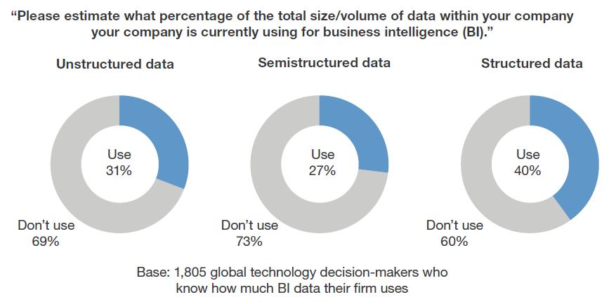
The Challenge Posed by Big Data

Slide 45
What is the Value of Big Data?
if US health care could use big data creatively and effectively to drive efficiency and quality…
Estimate that the potential value from data in the sector could be more than $300 billion in value every year,
Two-thirds of which would be in the form of reducing national health care expenditures by about 8 percent.
In the private sector…
A retailer using big data to the full has the potential to increase its operating margin by more than 60 percent.
In the developed economies of Europe…
A government administration could save more than €100 billion ($149 billion) in operational efficiency improvements alone

Slide 46
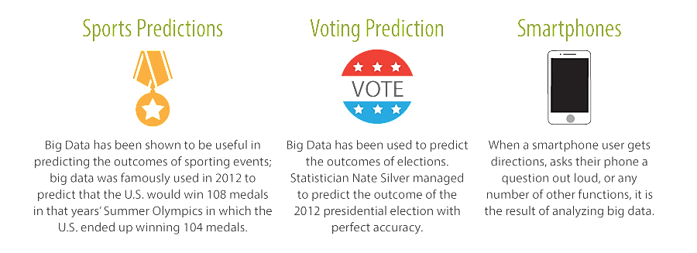
How Does Big Data Affect Our Daily Lives

Slide 47
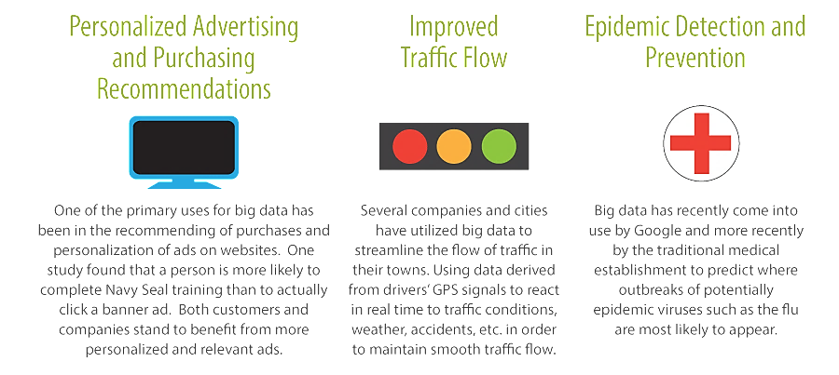
How Does Big Data Affect Our Daily Lives

Slide 48
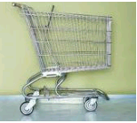

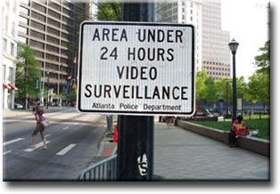


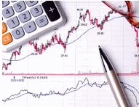
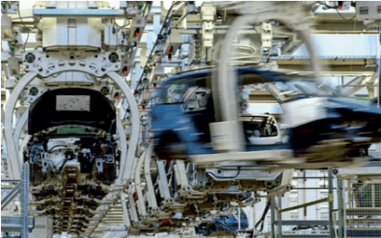

Big Data Use Cases
Smarter Healthcare
Multi-channel sales
Homeland
Security
Telecom
Traffic Control
Trading
Analytics
Search
Quality
Manufacturing

Slide 49
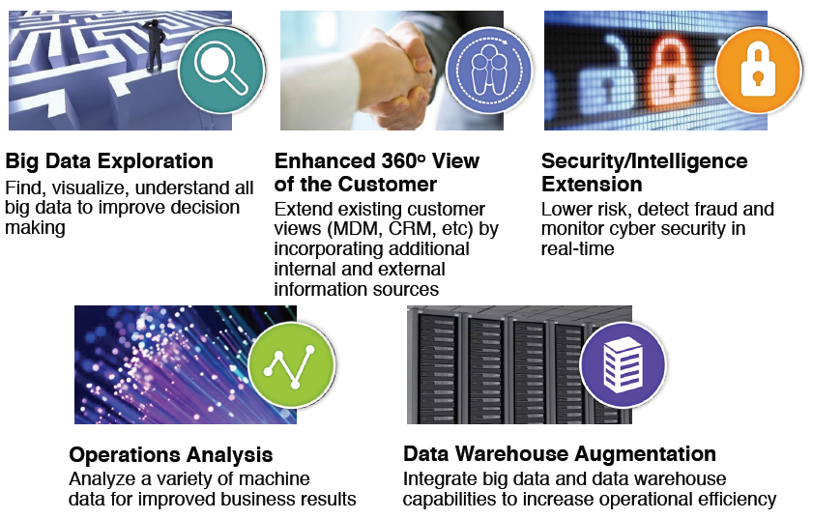
Big Data Use Cases

Slide 50
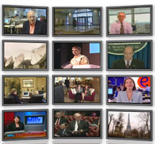

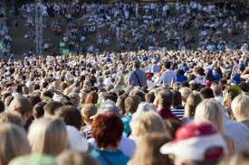

Changing Perspective
Old Model: Few companies are generating data, all others are
consuming data
New Model: all of us are generating data, and all of us are consuming data

Slide 51
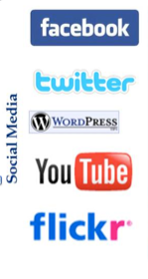


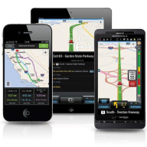


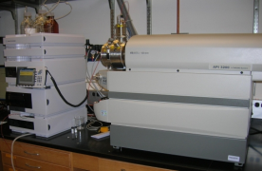
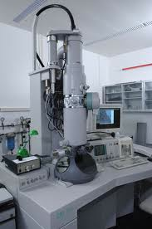
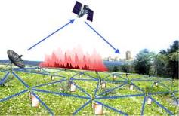

Who’s Generating Big Data
Mobile devices
(tracking all objects all the time)
Social media and networks
(all of us are generating data)
Scientific instruments
(collecting all sorts of data)
Sensor technology and networks
(measuring all kinds of data)
The progress and innovation is no longer hindered by the ability to collect data
But, by the ability to manage, analyze, summarize, visualize, and discover knowledge from the collected data in a timely manner and in a scalable fashion

Slide 52
Key Enablers
Increase of storage capacities
Increase of processing power
Increase of availability of data
Availability of the public cloud

Slide 53
The Road to Big Data Technology
You start out with a traditional database
SQL
Schemas
Relational Model
But… at some point the database can’t keep up with the write rate
Application
Oracle
MySQL
MS SQL Server
IBM DB2
Database

Slide 54
The Road to Big Data Technology
So you add a queue layer to buffer writes until the database can handle them
But… at some point the worker cant’ keep up & the queue buffer starts to grow out of control
Application
Buffers data waiting to be written
Queue
Writes at a rate the database can sustain
Worker
Database

Slide 55
The Road to Big Data Technology
So you add more workers to operate in parallel
But… at some point one or another worker fails
Application
Buffers data waiting to be written
Queue
Worker
Failed worker
Worker
Worker
X
Database

Slide 56
The Road to Big Data Technology
So you need to design recovery mechanisms
But… at some point the database can’t process writes fast enough
Application
Buffers data waiting to be written
Queue
Worker
Recovery
Manager
Worker
Worker
Database

Slide 57
The Road to Big Data Technology
So you think about buying a bigger database server
But… this is too expensive
Application
Buffers data waiting to be written
Queue
Worker
Recovery
Manager
Worker
Worker
Database
Scale up or vertically
$$$$

Slide 58
The Road to Big Data Technology
So you divide your data across multiple smaller cheaper database servers
But.. It becomes more difficult to manage the data
Application
Buffers data waiting to be written
Queue
Worker
Recovery
Manager
Worker
Worker
Database
Database
Which database holds the data I want
Database
Database
?

Slide 59
The Road to Big Data Technology
So… you add a metadata manager (a data tracking system)
But… at some point one or another databases fails
Application
Buffers data waiting to be written
Queue
Worker
Recovery
Manager
Worker
Worker
Failed database
Database
Database
Metadata Manager
Database
X
Database

Slide 60
The Road to Big Data Technology
So… you add a database recovery manager
But… now we created a complex ad-hoc system
Application
Buffers data waiting to be written
Queue
Worker
Recovery
Manager
Worker
Worker
Recovery
Manager
Database
Database
Metadata Manager
Database
Database

Slide 61
What You Really Need Purpose Built Big Data System
High availability and fault tolerance
Low latency reads and writes
Inexpensive scalability
Infinite compute capability
Infinite storage capability
Using commodity hardware
Or using cloud services
Flexibility
Accepts all varieties of data
Allows all sorts of queries
Easy changes to schemas
Ease of use
Easy to learn
Minimal maintenance
Extensible
A range of software tools and templates

Slide 62
Knowledge Discovery Process Impact of Big Data
Standard compute, storage, database, processing and other technologies cannot handle data of extremely high volume, velocity or variety
To do so requires use of non-traditional parallel processing technologies and new architectural patterns
The use of these technologies and patterns has practical impacts on all subsequent steps in the knowledge discovery process
Frame the problem
(Ask the right questions)
Obtain the right data
(Data ingestion, Data collection)
Process the data
(Data cleansing)
Explore the data
(Data profiling, Data transformation)
Analyze data in depth
(Data Mining)
Visualize and communicate results
(Use the discovered knowledge)
Define the Technical Architecture
(Establish data processing pipeline)
Ingest streams of data in real time or accept large volumes of batch data.
Employ big data parallel processing technology to process large volumes or batch or real-time data
Visualize aggregated or summarized data

Slide 63
Why is Big Data a Challenge?
Don’t collect so much data in the first place
Or just store part of the data until later when it can be processed
Or delete part of the data that can’t be stored or processed using the technology to hand
Or sample the data at the rate at which is can be processed and stored
And then discard the data that can’t be stored

Slide 64
Why is Big Data a Challenge?
Sometimes collecting large volumes of data is the point
Large Hadron Collider experiments to discover new physics
Images and other data from missions to the moon or Mars
Twitter, Facebook, Snapchat, YouTube, Instagram and so on
Sometimes big data happens (unexpectedly)
An ecommerce site starts small and then usage grows
Data collected about each user starts small and then is augmented with more details
Sometimes big data is a competitive business choice
Understand your customer better than other similar businesses
Or to meet some governance, legal or regulatory requirements
Sometimes it makes no sense to only sample data
Can’t record or analyze every other order a customer places
Sometimes more data is required for scientific (data analytic) reasons
More effective sentiment analysis or population health trending analysis
Good predictive algorithms applied to large data sets are often more accurate than great algorithms applied to smaller data sets

Slide 65
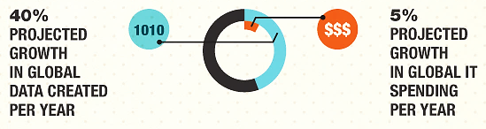
Another Challenge of Big Data
Data volume is growing 8X faster than IT budgets
=> We must find more cost efficient ways of managing big data

Slide 66
Organizational Challenges
Legacy IT: Many organizations are trying to manage healthcare and operational data using stagnant, closed, archaic clinical systems.
Data volume: Organizations must gather and make sense of all sorts of structured,
Data format: unstructured, internal, and external data from a myriad amount of sources from clinical systems to machine data (e.g., heart monitors).
Siloes: Data residing in a variety of systems that support different operational processes result in error prone, largely inefficient, and lost data.
Lack of integration: Disconnected systems like EMRs and clinical systems fail to provide the holistic view needed to identify gaps and opportunities.
Skills and tools: Keeping up with fast-changing and advancing Big Data technologies is a daunting task when time and resources are already constrained and competition for industry and technical talent remains fierce.

Slide 67
Why Are Big Data Systems Different?
The basic requirements for working with big data are the same as the requirements for working with datasets of any size.
However, the massive scale, the speed of ingesting and processing, and the characteristics of the data that must be dealt with at each stage of the process present significant new challenges when designing solutions.
The goal of most big data systems is to surface insights and connections from large volumes of heterogeneous data that would not be possible using conventional methods.
In 2001, Gartner's Doug Laney first presented what became known as the "three Vs of big data" to describe some of the characteristics that make big data different from other data processing
Volume, Velocity, Variety

Slide 68
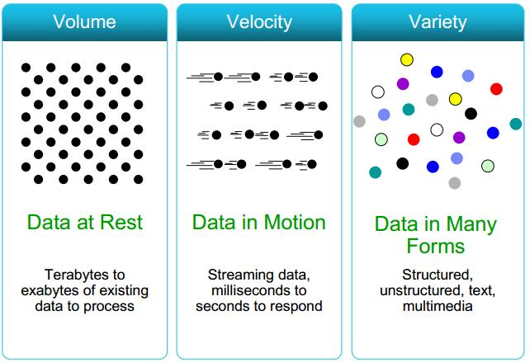
Attributes of Big Data (3 Vs)

Slide 69
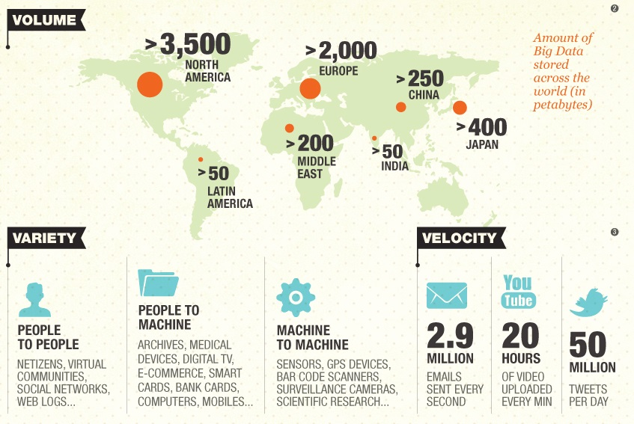
Some “Facts” About the 3 V’s

Slide 70
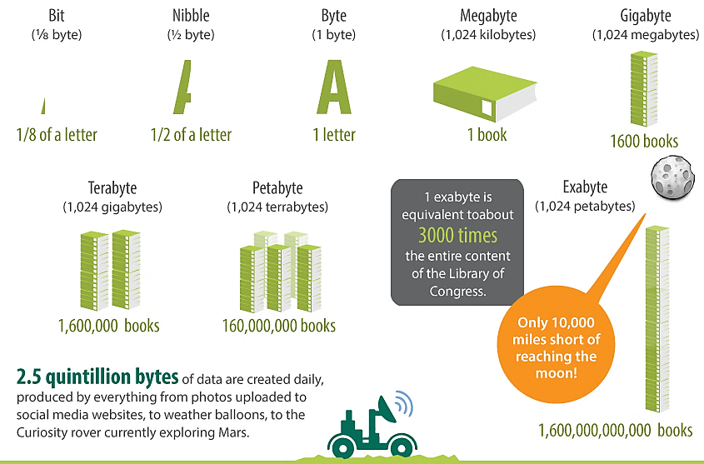
Volume

Slide 71
When is Big Data “Big?”
The 1980 US Census data would be considered as Big Data in the 1980s, where the IBM 3850 Mass Storage System with a capacity of 102.2GB was the monster storage device of its day
This would certainly not be considered as Big Data today where a personal computer can afford such capacity
In today’s environment, the size of datasets that may be considered as Big Data could range from
Terabytes (10¹² bytes)
Petabytes (10¹⁵ bytes)
Exabytes (10¹⁸ bytes)
Depending on the industry, how data is used

Slide 72
Volume
The sheer scale of the information processed helps define big data systems.
These datasets can be orders of magnitude larger than traditional datasets
Which demands more thought at each stage of the processing and storage life cycle.
Often, because the work requirements exceed the capabilities of a single computer, this becomes a challenge of pooling, allocating, and coordinating resources from groups of computers.
Cluster management and algorithms capable of breaking tasks into smaller pieces become increasingly important.

Slide 73
Volume
A typical PC might have had 10 gigabytes of storage in 2000.
Today, Facebook ingests 500 terabytes of new data every day.
Boeing 737 will generate 240 terabytes of flight data during a single flight across the US.
The smart phones, the data they create and consume; sensors embedded into everyday objects will soon result in billions of new, constantly-updated data feeds
Containing environmental, location, and other information, including video.

Slide 74
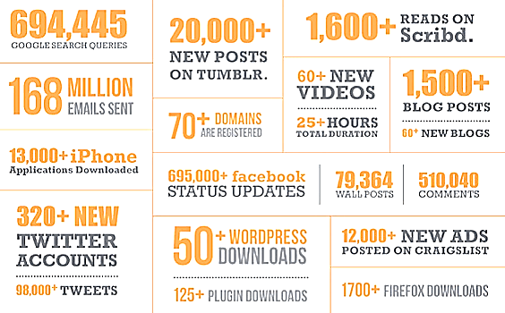
Data Collected in One Minute

Slide 75
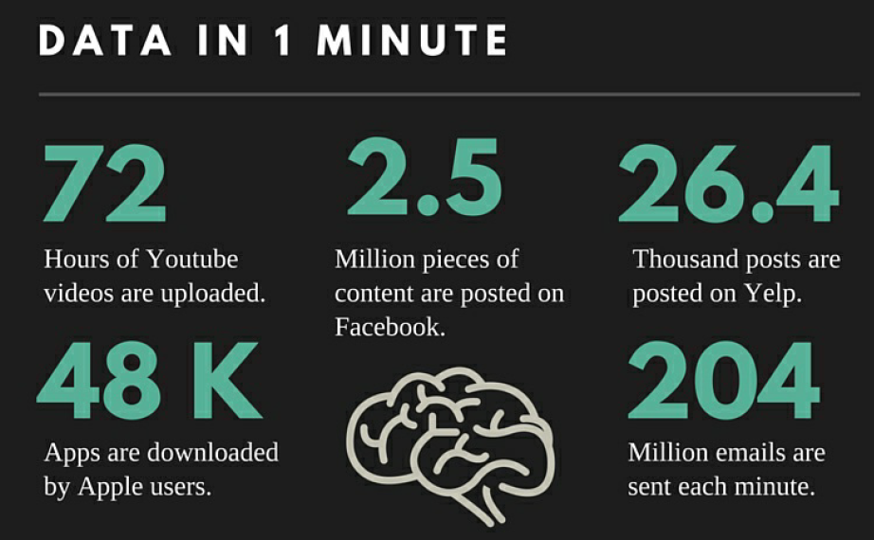
Some “Facts” About Big Data

Slide 76
Four Domains of Big Data in 2025 In each of the four domains, the projected annual storage and computing needs are presented across the data lifecycle.

Slide 77
A Brief Interlude…
How can we store all this data?
What if a data file is larger than any single
SSD (solid state drive) or hard disk?
What technology and what storage architecture
should be used?
How can we do so reliably?
And what might this cost?

Slide 78
A Brief Interlude…
We are going to explore a range of approaches
to addressing these questions
But let’s start with one that
is gaining popularity
Public cloud hosted block storage
as a service

Slide 79
But First Let’s Think of File Systems
When you access a file system you must do so through a server or virtual machine running an operating system
So file storage, operating system and compute capability are all coupled together to some degree
For example, the Linux file system is organized differently to that provided via MS Windows
And that means that Windows files can only be read if you have an active Windows machine (or translation software)
The storage systems that file systems are built over CAN be expanded to files of almost and size
But this requires costly hardware along with operational maintenance, and capability for backup and restore

Slide 80
Now Let’s Think of the Internet
You can retrieve a pdf document, a song, a web page, an image, an HTML web page, and so forth
Consider the providers of this content as offering storage services holding content until you request it
And the interface to these services is the HTTP protocol
GET content
PUT content
These services are operating system independent and leave it to the requestor to interpret the stored content
And the requestor does not care through what means or where the content was stored

Slide 81
Now Let’s Think of the Internet
There is no notion of directories or subdirectories, just a host name and a path to the content of interest
http://www.somehostname.com/documents/grades.pdf
The host name is the name of a container for content
www.somehostname.com
The path identifies the specific content item
/documents/grades.pdf
And the interface to these services is via the HTTP (or REST) protocol

Slide 82
From the Internet to Object Stores
What if we were able to provide storage of content
Independent of servers, operating systems and file systems?
What if we made this storage available as a (REST) service over the Internet?
What is this service could store terabytes to petabytes of data?
What is this service was highly available, very durable, secure?
Oh, and what if it was very cheap, too?
Then we would have an Object Store

Slide 83



From the Internet to Object Stores
Object stores are often cloud services accessible from the Internet
Instead of providing other’s content they allow users to upload (store) and download (retrieve) content of their own
Allows content of nearly unlimited size to be uploaded & downloaded
In an object store each content item is stored as an object
An object consist of a globally unique identifier (GUID), some metadata, and the content itself
An objects GUID is also know as its key
An object store holds groups of related object together in collections, each having a unique name
A collection is sometimes called a bucket
Collection
Object Store
Service
Collection
Upload or download
content
Object
User
Internet
Object
Public Cloud

Slide 84
From the Internet to Object Stores
An object is data (think a file) tagged with a key (think file name)
Object data is treated as just a sequence of bytes (think blob)
A bucket is container of objects (think directory) tagged with a name
Buckets hold objects only and not other buckets (think no sub-directories)
A bucket name must be unique across all of AWS
If the bucket name is “myawsbucket” it is addressed as https://myawsbucket.s3.amazonaws.com
An object key must be unique within a bucket
If the ley is “myobject” then it can be addressed as
https://myawsbucket.s3.amazonaws.com/myobject
Objects are “write once, read any” (WORM)
You can only write a whole object at a time
Once the object is written you can’t update or append to it

Slide 85
Amazon S3
Simple Storage Service
Secure, durable, highly-scalable object storage
Accessible via a simple web services interface
Store & retrieve any amount of data
Use alone or together with other AWS services

Slide 86
Amazon S3 Concepts
Buckets
Containers for objects stored in S3
Organize the Amazon S3 namespace at the highest level
Each bucket has a name unique across AWS
Objects
Fundamental entities stored in Amazon S3
Consist of data & metadata
Data portion is opaque to Amazon S3
Metadata is a set of name-value pairs that describe the object
Object is uniquely identified within a bucket by a key (name) and a version ID

Slide 87
Amazon S3 Concepts
Keys
Unique identifier for an object within a bucket.
Every object in a bucket has exactly one key
Combination of a bucket name, object key & version ID uniquely identify each object

Slide 88
Amazon S3 Concepts
Globally Unique
Bucket Name + Object Name (key)

Slide 89
Amazon S3 Concepts
Globally Unique
Bucket Name + Object Name (key)
Amazon S3
bucket
bucket
bucket
object
object
object
object
object
object

Slide 90
Amazon S3 Concepts
Globally Unique
Bucket Name + Object Name (key)
Amazon S3
Amazon S3
bucket
ianm-aws-docs
bucket
ianm-aws-bootstrap
bucket
aws-exampl.es
object
s3-webinar.pptx
object
vid/s3-webinar.mp4
object
wp/bootstrap.sh
object
wp/credentials.txt
object
index.html
object
logo.png

Slide 91


Amazon S3 Concepts
Object key
Max 1024 bytes UTF-8
Including ‘path’ prefixes
Unique within a bucket
assets/js/jquery/plugins/jtables.js
an example object key

Slide 92
Amazon S3 Concepts
A web store, not a file system
Write once, Read many
Eventually consistent

Slide 93
Amazon S3 Concepts

Slide 94
Amazon S3 Concepts
name
A bucket name must be unique across all of AWS
If the bucket name is “myawsbucket” then it could be addressed as https://myawsbucket.s3.amazonaws.com
has
Objects are the fundamental entities stored in Amazon S3
Bucket
holds
Object
An object is uniquely identified within a bucket by a key (name)
If the key is “myobject” then it can be addresses as https://myawsbucket.s3.amazonaws.com/myobject
A bucket is a container used for storing objects in S3
There is no limit to the number of objects that can be stored in an S3 bucket
has
has
data
key
An object is associated with a sequence (blob) of bytes

Slide 95
Velocity
Another way in which big data differs significantly from other data systems is the speed that information moves through the system.
Data is frequently flowing into the system from multiple sources and is often expected to be processed in real time
To gain insights and update the current understanding of the system.
This focus on near instant feedback has driven many big data practitioners away from a batch-oriented approach and closer to a real-time streaming system.
Data is constantly being added, massaged, processed, and analyzed in order to keep up with the influx of new information.
This require robust systems with highly available components to guard against failures along the data pipeline.

Slide 96
Velocity
Some Internet of Things (IoT) applications have health and safety ramifications that require real-time evaluation and action.
Other internet-enabled smart products operate in real-time or near real-time.
As an example, consumer eCommerce applications seek to combine mobile device location and personal preferences to make time sensitive offers.
Operationally, mobile application experiences have large user populations, increased network traffic, and the expectation for immediate response.

Slide 97
Velocity
Clickstreams and ad impressions capture user behavior at millions of events per second
High-frequency stock trading algorithms reflect market changes within microseconds
Machine to machine processes exchange data between billions of devices
Infrastructure and sensors generate massive log data in real-time
On-line gaming systems support millions of concurrent users, each producing multiple inputs per second.

Slide 98
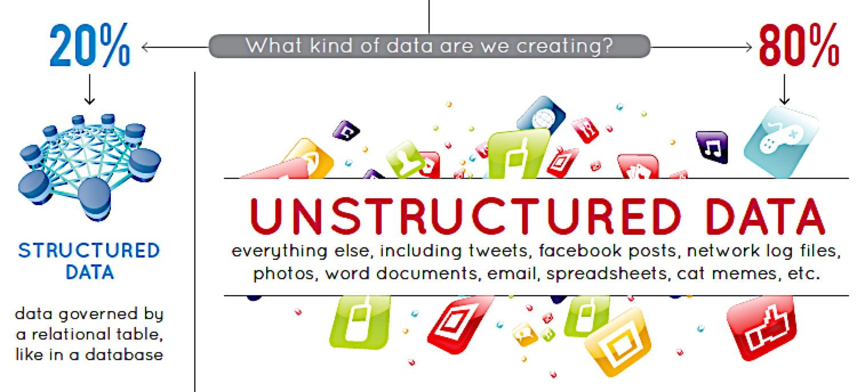
Variety

Slide 99
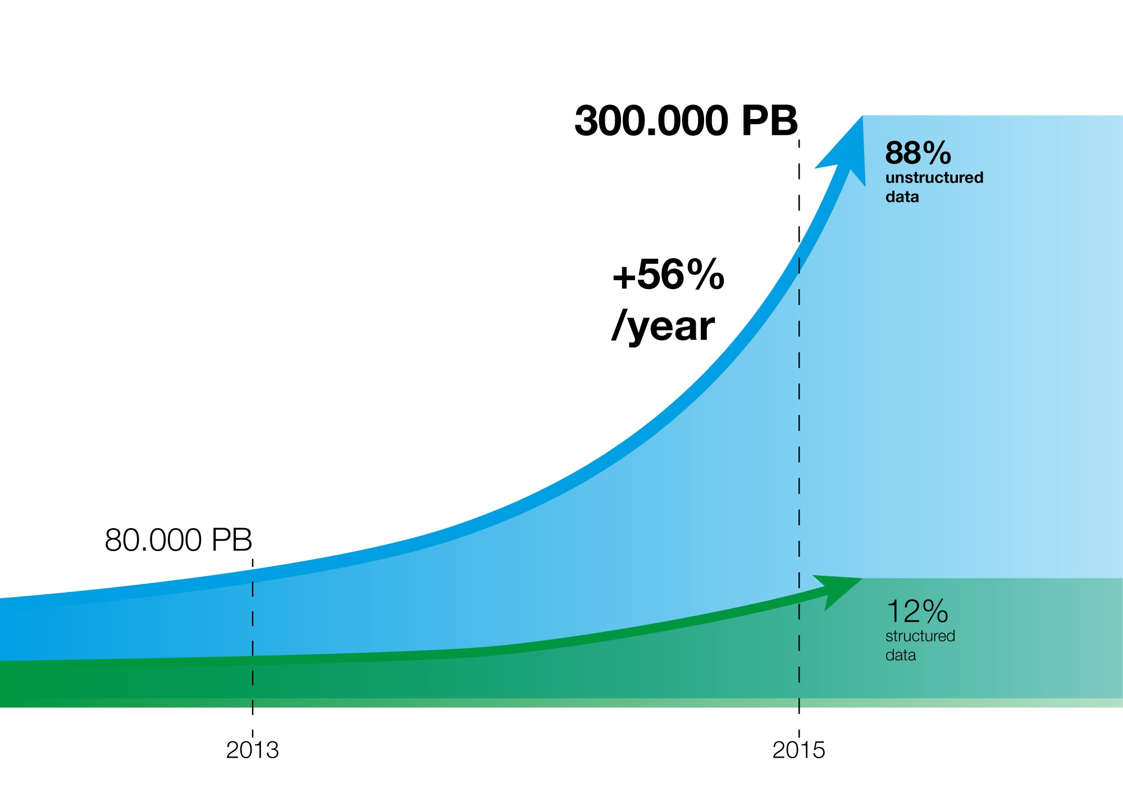
Variety

Slide 100
Variety
Unstructured and semi-structured data types, such as text, audio, and video require additional processing to both derive meaning and the supporting metadata.
Once understood, unstructured data has many of the same requirements as structured data, such as summarization, lineage, auditability, and privacy.
Further complexity arises when data from a known source changes without notice.
Frequent or real-time schema changes are an enormous burden for both transaction and analytical environments.

Slide 101
Structured Data
Exemplified by data contained in relational databases and spreadsheets.
Structured data conforms to a database model, which is largely characterized by…
The various fields that data belongs to (name, address, age and so forth)
The data type for each field (numeric, currency, alphabetic, name, date, address).
The model also has a notion of restrictions or constraints on each field (for example, integers in a certain range)…
And constraints between elements in the various fields that are used to enforce a notion of consistency
No duplicates, cannot be scheduled in two different places at the same time, etc.

Slide 102
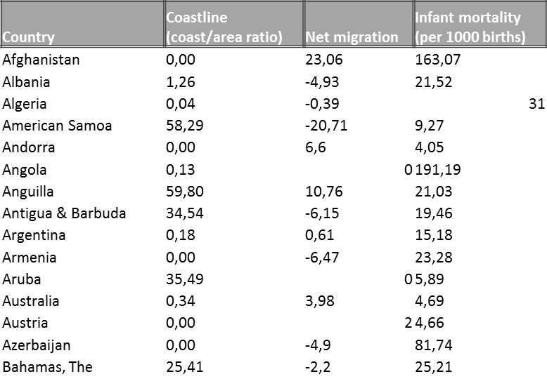
Structured Data Example
Country | Region | Population | Area (sq. mi.) | Pop. Density (per sq. mi.)
Afghanistan | ASIA (EX. NEAR EAST) | 31056997 | 647500 | 48,0
Albania | EASTERN EUROPE | 3581655 | 28748 | 124,6
Algeria | NORTHERN AFRICA | 32930091 | 2381740 | 13,8
American Samoa | OCEANIA | 57794 | 199 | 290,4
Andorra | WESTERN EUROPE | 71201 | 468 | 152,1
Angola | SUB-SAHARAN AFRICA | 12127071 | 1246700 | 9,7
Anguilla | LATIN AMER. & CARIB | 13477 | 102 | 132,1
Antigua & Barbuda | LATIN AMER. & CARIB | 69108 | 443 | 156,0
Argentina | LATIN AMER. & CARIB | 39921833 | 2766890 | 14,4
Armenia | C.W. OF IND. STATES | 2976372 | 29800 | 99,9
Aruba | LATIN AMER. & CARIB | 71891 | 193 | 372,5
Australia | OCEANIA | 20264082 | 7686850 | 2,6
Austria | WESTERN EUROPE | 8192880 | 83870 | 97,7
Azerbaijan | C.W. OF IND. STATES | 7961619 | 86600 | 91,9
Bahamas, The | LATIN AMER. & CARIB | 303770 | 13940 | 21,8

Slide 103
Unstructured Data
Unstructured Data (or unstructured information) refers to information that either does not have a pre-defined data model or is not organized in a predefined manner.
Unstructured information is typically text-heavy, but may also contain data such as dates, numbers, and facts.
Other examples include the “raw” (untagged) data representing photos and graphic images, videos, streaming sensor data, web pages, PDF files, PowerPoint presentations, emails, blog entries, wikis, and word processing documents

Slide 104

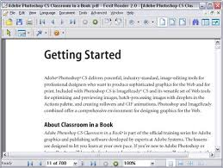
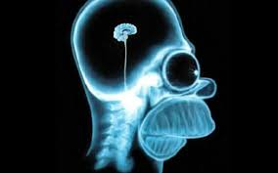
Unstructured Data Example
Animation
Word Doc
X-Ray Image

Slide 105
Semi-Structured Data
Semi-structured data lies in between structured and unstructured data.
It is a type of structured data, but lacks a strict structure imposed by an underlying data model.
With semi-structured data, tags or other types of markers are used to identify certain elements within the data, but the data doesn’t have a rigid structure from which complete semantic meaning can be easily extracted without much further processing.
For example, word processing software now can include metadata showing the author's name and the date created, while the bulk of the document contains unstructured text.
Sophisticated learning algorithms would have to mine the text to understand what the text was about, because no model exists that classifies the text into neat categories
As an additional nuance, the text in the document may be further tagged as including table of contents, chapters, and sections.
Emails have the sender, recipient, date, time and other fixed fields added to the unstructured data of the email message content and any attachments.
Photos or other graphics can be tagged with keywords such as the creator, date, location

Slide 106
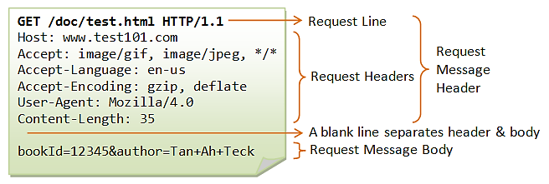
Semi-Structured Data Examples
HTTP Request
Medical Record
Component | Your Value
GLUCOSE | 108 mg/dL
SODIUM | 136 meq/L
POTASSIUM | 4.0 meq/L
CHLORIDE | 101 meq/L
Study Result
Impression
IMPRESSION: 1. Stable simple cystic pancreatic foci, which likely reflect side branch intraductal papillary mucinous neoplasms; follow up in 2 years is recommended per guidelines provided below. 2. Unchanged hemorrhagic/proteinaceous left renal cyst.

Slide 107
Other Characteristics
Various individuals and organizations have suggested expanding the original three Vs:
Veracity: The variety of sources and the complexity of the processing can lead to challenges in evaluating the quality of the data (and consequently, the quality of the resulting analysis)
Variability: Variation in the data leads to wide variation in quality.
Additional resources may be needed to identify, process, or filter low quality data to make it more useful.
Value: The ultimate challenge of big data is delivering value.
Sometimes, the systems and processes in place are complex enough that using the data and extracting actual value can become difficult.

Slide 108
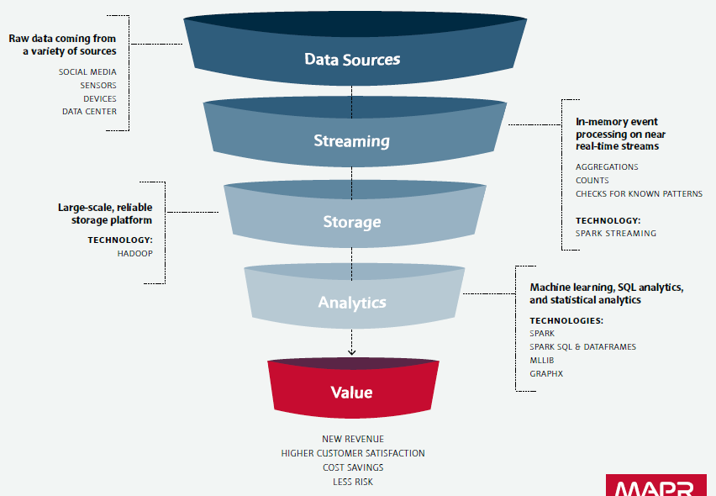

Value

Slide 109
Value from Big Data in Healthcare
Optimize costs
The McKinsey Global Institute estimates that the potential value from Big Data in healthcare could reach more than $300 billion USD a year.
Reducing preventable readmissions
Comply with a U.S. Affordable Care Act provision that reduces payouts to Medicare Prospective Payment Systems (PPS) hospitals with excess readmissions.
Implementing proper discharge planning and instructions for cardiac patients could save a 350-bed hospital $486,000 USD every year.
Improving physician and worker performance
Help improve physician performance by giving them the tools to create treatment plans based on information that validates what has
This supports more targeted treatments that can translate into bottom line savings.
Drive greater operational efficiencies
Applying proven data analytics in every area of the organization leads to better decisions being made in real time that will result in more efficiently run facilities.

Slide 110
Value from Big Data in Healthcare
Improve patient care
Two-thirds of executives working in federal healthcare agencies believe that Big Data will improve population health management and preventive care
Know patients better: Healthcare providers can achieve a total view of a patient
By combining multiple data sources, such as medical device data, public health data, and socioeconomic data
Track patients better: Big Data extends beyond any individual organization, which what makes it so valuable.
By tracking things like patient populations, current events, weather patterns, and other third-party data sources, healthcare providers can achieve greater visibility into the impact of care

Slide 111
Possible Definition
Big Data refers to datasets whose size is beyond the ability of typical database software tools to capture, store, manage, and analyze.
The concept of Big Data is therefore relative to the storage and processing capability of prevalent technology of the time.
Manyika, J., Chui, M., Brown, B., Bughin, J., Dobbs, R., Roxburgh, C., & Byers, A. H. (2011). Big data: The next frontier for innovation, competition, and productivity. New York, NY: McKinsey Global Institute.

Slide 112
Possible Definition (Famous)
Big Data is the frontier of a firm's ability to store, process, and access all the data it needs to operate effectively, make decisions, reduce risks, and serve customers
Forrester

Slide 113
Possible Definition (Famous)
Big Data in general is defined as high volume, velocity and variety information assets that demand cost-effective, innovative forms of information processing for enhanced insight and decision making
Gartner
Gartner, Inc. (2011, June 27). Gartner says solving ‘big data’ challenge involves more than just managing volumes of data [Press release]. Retrieved from http://www.gartner.com/ newsroom/id/1731916

Slide 114
Possible Definition
Big data is data that exceeds the processing capacity of conventional database systems. The data is too big, moves too fast, or doesn't fit the strictures of your database architectures. To gain value from this data, you must choose an alternative way to process it
O’Reilly

Slide 115
Possible Definition
“Big data” refers to datasets whose size is beyond the ability of typical database software tools to capture, store, manage, and analyze
This definition is intentionally subjective and incorporates a moving definition of how big a dataset needs to be in order to be considered big data
We don’t define big data in terms of being larger than a certain number of terabytes (thousands of gigabytes).
We assume that, as technology advances over time, the size of datasets that qualify as big data will also increase

Slide 116
Possible Definition
Big data is a generic term for the non-traditional strategies and technologies needed to gather, organize, process, and gather insights from large datasets.
While the problem of working with data that exceeds the computing power or storage of a single computer is not new, the pervasiveness, scale, and value of this type of computing has greatly expanded in recent years.

Slide 117
So What Is Big Data?
An exact definition of “big data" is difficult to nail down because projects, vendors, practitioners, and business professionals use it quite differently.
With that in mind, generally speaking, big data is:
Large datasets having a range of structures
The category of computing strategies and technologies that are used to handle large datasets
In this context, "large dataset" means a dataset too large to reasonably process or store with traditional tooling or on a single computer.
The common scale of big datasets is constantly shifting and may vary significantly from organization to organization.

Slide 118
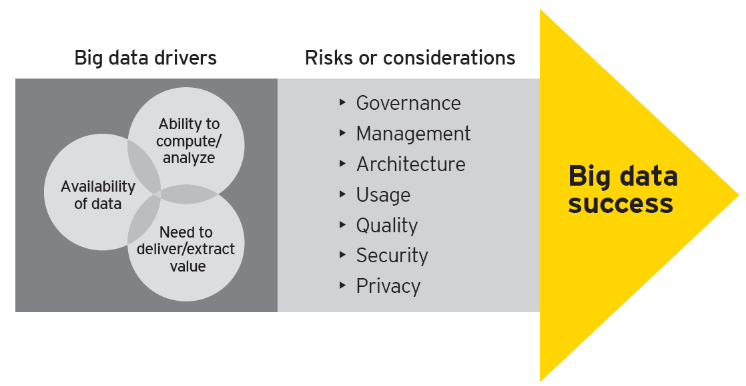
Big Data Drivers and Risks

Slide 119
Governance
Managers will need to learn to embrace the evidence-based decision-making process.
Organizations have to redefine their understanding of “judgements” of the outcome of big data analytics.
Data can be of great value, but companies have to consider ownership and privacy issues before using big data results.
In the case of medical data, it is sometimes not clear who is the owner of the data, but using the data without the right legal foundation or consent of the patient may cause big problems.
Big data may bring about intellectual property issues, e.g. copyright and database rights infringements.
It will be a challenge to make sure that employees are not sharing inappropriate information, or too much data outside of the organization.

Slide 120
Management
Simplified access to diverse sources of data and easy-to-ingest large amounts of information may result in increasing amount of “noise” in data and decrease in the overall level of data quality.
Many new technology market players don’t have mature enterprise-ready capabilities around implementation, support, training, etc.
New big data methods, architecture and volume variety impose additional risks of lack of control and governance over data, and this requires additional organizational focus.
Under the context of the complex data landscape, it is especially important to establish and maintain data lineage.
Organizations may struggle with finding the right skills and building internal capabilities for handling big data as most technologies and methods are relatively new, and market resources are in short supply.

Slide 121
Architecture
More is not always better. More data can lead to an increased number of data quality issues, and confusion and lack of consistency in business decision making
Especially when conflicting information is present.
Integrated data architecture increases the challenges of data linkages and matching algorithms to distinguish items of relevance from piles of data.
Increased complexity of architectural landscape and the growing amount of data bring new challenges around data governance and data privacy.
Lack of capabilities, both within organizations and externally, make it hard to keep up with rapidly evolving hardware/software technology and implementation methods.

Slide 122
Usage
A key challenge is to know the right business questions to ask.
There are misunderstandings over what data is needed to make strategic or operational decisions.
Many organizations do not have the ability to analyze data timely enough to take advantage of new insights.
Not considering information from outside the organization (e.g., weather) that is relevant to answering bigger question is an ongoing concern.
Organizations can get overloaded and overwhelmed by trying to handle too much data.
The challenge of getting the right information to the right person at the right time is expanded due to the sheer size of big data.
The costs associated with managing and monitoring the quality, credibility and integrity of big data can be prohibitive.
There is a necessity to temper the expectation that big data will solve everything.

Slide 123
Quality
A key concern is building and maintaining golden sources of data and determining which data sources should be golden.
Understanding the data domains and the level of data quality required for each data domain creates risk.
The need to interpret and assess unstructured data can be a challenge, and the quality of the unstructured data is often unproven.
Structured and unstructured data may not be integrated cohesively.
Existing information governance models will not be aligned to manage data quality for the newly acquired data.

Slide 124
Security
Diverse sources of data results in distributed storage and management, compounding security vulnerabilities.
Cloud computing puts more data in motion and causes additional security complexities.
Lost data results in more direct impact to the end consumer. This, coupled with the behavioral data collected, can lead to more sophisticated attacks, e.g., social engineering attempts on targeted consumers.
Increasing global regulations raise the stakes around security as the cost of dealing with data breaches continues to grow.

Slide 125
Privacy
Privacy considerations around personal information have always existed, but companies have traditionally dealt with them on a limited or single location basis.
Sensor and geolocation data may be used to identify an individual, even if no name is attached to the data, therefore increasing the need to define “personal information” that needs to be protected.
The ability to collect new sources of information, like car-based sensor data, increases the need to evaluate opt-in/opt-out procedures by consumers.

Slide 126
Big Data Pipeline
So how is data actually processed when dealing with a big data system?
While approaches differ, there are some commonalities in the strategies and software that we can talk about generally.
The general steps of activities involved with big data processing are:
Ingesting data into the system
Persisting the data in storage
Computing and Analyzing data
Visualizing the results
Data Sources
Data Ingestion
Data Analysis
Data Visualization
Data Storage

Slide 127
Ingesting Data into the System
Data ingestion is the process of taking raw data and adding it to the system.
The complexity of this operation depends heavily on the format and quality of the data sources
And how far the data is from the desired state prior to processing.
One way that data can be added to a big data system are dedicated ingestion tools.
Apache Sqoop can take existing data from relational databases and add it to a big data system.
Apache Flume is designed to aggregate and import application and server logs.
Queuing systems like Apache Kafka can also be used as an interface between various data generators and a big data system

Slide 128
Ingesting Data into the System
This process is sometimes called ETL, which stands for extract, transform, and load.
While this term conventionally refers to legacy data warehousing processes, some of the same concepts apply to data entering the big data system.
Typical ETL operations might include
Modifying the incoming data to format it
Categorizing and labelling data
Filtering out unneeded or bad data, or potentially validating that it adheres to certain requirements.
With those capabilities in mind, ideally, the captured data should be kept as raw as possible
For greater flexibility further on down the pipeline.

Slide 129
Persisting the Data in Storage
The ingestion processes typically hands data off to components that manage storage, so that it can be reliably persisted to disk.
While this seems like it would be a simple operation, the volume of incoming data, the requirements for availability, and the distributed computing layer make more complex storage systems necessary.
This usually means leveraging a distributed file system for raw data storage.
Apache Hadoop's HDFS filesystem allow large quantities of data to be written across multiple nodes in the cluster.
This ensures that the data can be accessed by compute resources, can be loaded into the cluster's RAM for in-memory operations, and can gracefully handle component failures

Slide 130
Persisting the Data in Storage
Distributed databases, especially NoSQL databases, are well-suited for this role
They are often designed with fault tolerant considerations
And can handle heterogeneous data.
There are many different types of distributed databases to choose from
Depending on how you want to organize and present the data.

Slide 131
Computing and Analyzing Data
Once the data is available, the system can begin processing the data to surface actual information.
The computation layer is perhaps the most diverse part of the system
As the requirements and best approach can vary significantly depending on what type of insights desired.
Data is often processed repeatedly, either iteratively by a single tool or by using a number of tools to surface different types of insights.
Batch processing is one method of computing over a large dataset.
The process involves breaking work up into smaller pieces, scheduling each piece on an individual machine, reshuffling the data based on the intermediate results, and then calculating and assembling the final result.
his is the strategy used by Apache Hadoop's MapReduce.
Batch processing is most useful when dealing with very large datasets that require quite a bit of computation

Slide 132
Computing and Analyzing Data
While batch processing is a good fit for certain types of data and computation, other workloads require more real-time processing.
Real-time processing demands that information be processed and made ready immediately and requires the system to react as new information becomes available.
One way of achieving this is stream processing, which operates on a continuous stream of data composed of individual items.
Another common characteristic of real-time processors is in-memory computing
Which works with representations of the data in the cluster's memory to avoid having to write back to disk.

Slide 133
Computing and Analyzing Data
Apache Storm and Apache Spark provide different ways of achieving real-time or near real-time processing.
There are trade-offs with each of these technologies, which can affect which approach is best for any individual problem.
In general, real-time processing is best suited for analyzing smaller chunks of data that are changing or being added to the system rapidly.

Slide 134
Computing and Analyzing Data
These tools frequently plug into the above frameworks and provide additional interfaces for interacting with the underlying layers.
For instance, Apache Hive provides a data warehouse interface for Hadoop
Apache Pig provides a high level querying interface
SQL-like interactions with data can be achieved with projects like Apache Impala, Apache Spark SQL, and Presto.
For machine learning, projects like Apache Mahout, and Apache Spark's MLlib can be useful.
For straight analytics programming that has wide support in the big data ecosystem, both R and Python are popular choices.

Slide 135
Visualizing the Results
Due to the type of information being processed in big data systems, recognizing trends or changes in data over time is often more important than the values themselves.
Visualizing data is one of the most useful ways to spot trends and make sense of a large number of data points.
One visualization technology typically used for interactive data science work is a data "notebook".
Popular examples of this type of visualization interface are Apache Zeppelin and Project Jupyter
Another approach is to support dynamic creation of ad-hoc visualizations
Some (commercial) examples include Tableau and Spotfire

Slide 136
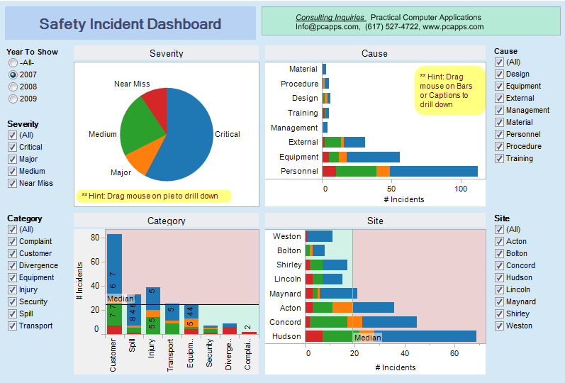
Visualizing the Results

Slide 137
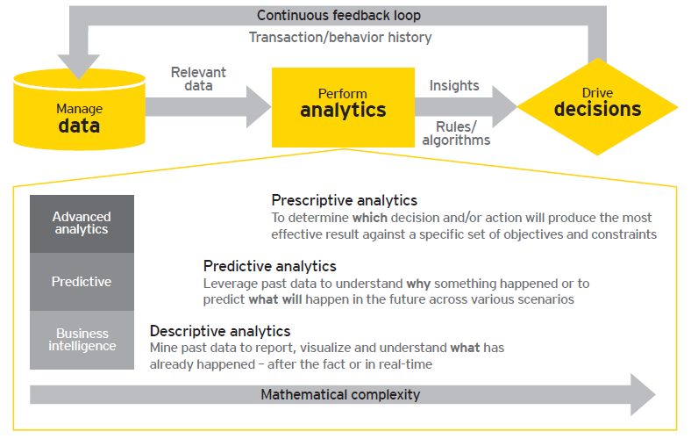
Another Data Pipeline Perspective

Slide 138
Conclusion
Big data is a broad, rapidly evolving topic.
While it is not well-suited for all types of computing, many organizations are turning to big data for certain types of work loads and using it to supplement their existing analysis and business tools.
Big data systems are uniquely suited for surfacing difficult-to-detect patterns and providing insight into behaviors that are impossible to find through conventional means.
By correctly implement systems that deal with big data, organizations can gain incredible value from data that is already available.

Slide 139
Big Data Glossary
Big data: Big data is an umbrella term for datasets that cannot reasonably be handled by traditional computers or tools due to their volume, velocity, and variety. This term is also typically applied to technologies and strategies to work with this type of data.
Batch processing: Batch processing is a computing strategy that involves processing data in large sets. This is typically ideal for non-time sensitive work that operates on very large sets of data. The process is started and at a later time, the results are returned by the system.
Cluster computing: Clustered computing is the practice of pooling the resources of multiple machines and managing their collective capabilities to complete tasks. Computer clusters require a cluster management layer which handles communication between the individual nodes and coordinates work assignment.

Slide 140
Big Data Glossary
Data lake: Data lake is a term for a large repository of collected data in a relatively raw state. This is frequently used to refer to the data collected in a big data system which might be unstructured and frequently changing. This differs in spirit to data warehouses (defined below).
Data mining: Data mining is a broad term for the practice of trying to find patterns in large sets of data. It is the process of trying to refine a mass of data into a more understandable and cohesive set of information.
Data warehouse: Data warehouses are large, ordered repositories of data that can be used for analysis and reporting. In contrast to a data lake, a data warehouse is composed of data that has been cleaned, integrated with other sources, and is generally well-ordered. Data warehouses are often spoken about in relation to big data, but typically are components of more conventional systems.

Slide 141
Big Data Glossary
ETL: ETL stands for extract, transform, and load. It refers to the process of taking raw data and preparing it for the system's use. This is traditionally a process associated with data warehouses, but characteristics of this process are also found in the ingestion pipelines of big data systems.
Hadoop: Hadoop is an Apache project that was the early open-source success in big data. It consists of a distributed filesystem called HDFS, with a cluster management and resource scheduler on top called YARN (Yet Another Resource Negotiator). Batch processing capabilities are provided by the MapReduce computation engine. Other computational and analysis systems can be run alongside MapReduce in modern Hadoop deployments.
In-memory computing: In-memory computing is a strategy that involves moving the working datasets entirely within a cluster's collective memory. Intermediate calculations are not written to disk and are instead held in memory. This gives in-memory computing systems like Apache Spark a huge advantage in speed over I/O bound systems like Hadoop's MapReduce.

Slide 142
Big Data Glossary
Machine learning: Machine learning is the study and practice of designing systems that can learn, adjust, and improve based on the data fed to them. This typically involves implementation of predictive and statistical algorithms that can continually zero in on "correct" behavior and insights as more data flows through the system.
Map reduce (big data algorithm): Map reduce (the big data algorithm, not Hadoop's MapReduce computation engine) is an algorithm for scheduling work on a computing cluster. The process involves splitting the problem set up (mapping it to different nodes) and computing over them to produce intermediate results, shuffling the results to align like sets, and then reducing the results by outputting a single value for each set.
NoSQL: NoSQL is a broad term referring to databases designed outside of the traditional relational model. NoSQL databases have different trade-offs compared to relational databases, but are often well-suited for big data systems due to their flexibility and frequent distributed-first architecture.
Stream processing: Stream processing is the practice of computing over individual data items as they move through a system. This allows for real-time analysis of the data being fed to the system and is useful for time-sensitive operations using high velocity metrics.

